Slide 2
Executive Summary
The contracting industry suffers from a lot of problems on the level of independent contracting such as transparency ,delays ,..etc .To solve such problems ,we developed a mobile application that will serve with a team of experts as a modern solution for all the problems .So basically our idea is to make independent contracting more customer-friendly , precise and transparent .

Slide 3
problem
Construction and repair industry has been facing alot of difficulties and problems especially on the independent contracting level from cost overruns because of bad estimations to unclear project details , delays , misunderstandings about the work and expectations ,and the lack of communication .

Slide 4
Solution
With our app ‘3mrly’(عمّرلي) and our team of experts say goodbye to all those problems . Our app is specifically designed to boost communication between the client and overall enhances the whole client experience and interaction with the team leading to a house more suitable to the his expectations in both featural and financial aspects .To do so , our app supplies a lot of features :
Online booking for meetings and consultations .
Access to project documents related to the construction plan and execution .
A budget section that specifies the price for each task providing transparency .
A full schedule of tasks and their due date .
Real time tracking for the construction progress :
The customer can see all the progress in each task during construction with photo/video documentation and detailed notes to each task .

Slide 5
Online chatting with experts or administration regarding any detail in the project .
Our team of experts also help in setting the budget for the project , and making sure that everything goes as planned , also that the final cost doesn’t exceed the initial estimate .

Slide 6
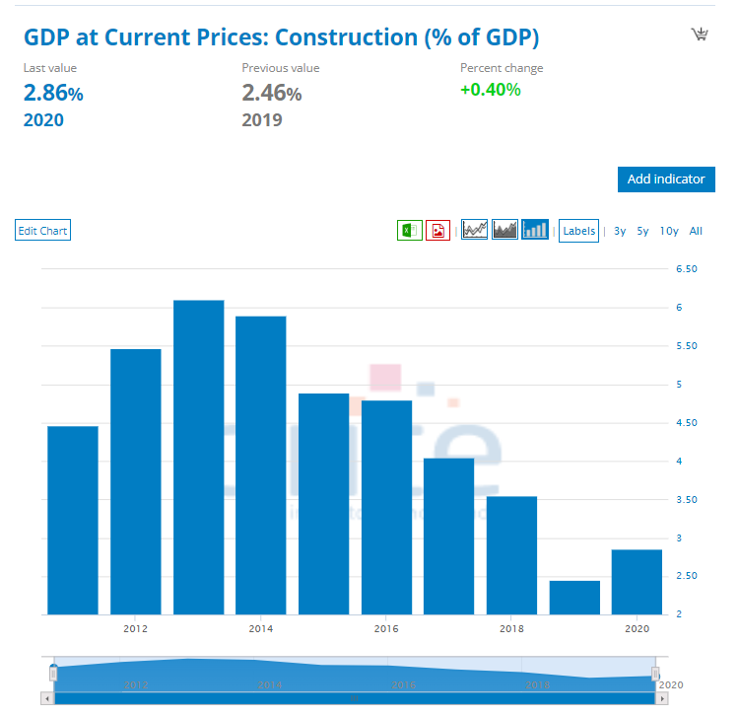
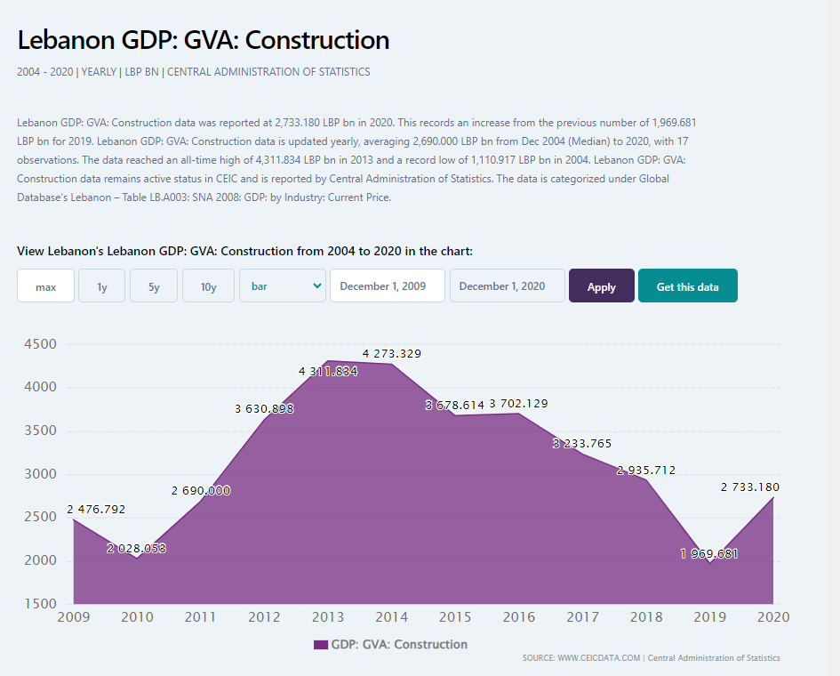
Market analysis
The construction sector had a good share in the GDP ( 3.55% in 2018 ) and employed approximately 7% of the workforce before the crisis .However , it has been on a decline these recent years because of economic and political problems . Recently , the market is showing signs of slow recovery , and with the end of the ongoing war it will heal more and open new work opportunities .

Slide 7
Cost ,revenues ,profits (financial projections)

Slide 8
marketing
Our marketing strategy is split into 2 parts :
Social media marketing : by creating pages on different platforms to post specific content and ads about the business and to interact with customers .
Using personal connections to share the business and spread it to people .

Slide 9
Milestone & timeline

Slide 10
App Layout

Slide 11
Targeted customers

Slide 12
Risks and solutions

Slide 13
Value Propositions
Note : Prb , sltion , market analysis , marketing , competetors ,how can I defeat comp , cost , revenue , profit , sustainability

Slide 14
Is the provided solution adequate ?
This solution proves itself to be adequate because it doesn’t require alot of capital to start the business and get it running .Also the business solves the problems that the contracting industry suffer from in Lebanon .

